Slide 1
Evolve 2016 Feedback
Gert Smith
Attendee
Notes:
Xamarin Introduction!

Slide 2

Xamarin Evolve is the largest cross-platform mobile event in the world, where over 1,500 developers, industry leaders, and Xamarin experts converge to advance the state of the art, discuss mobile strategy, and define the future of apps.
Notes:
Xamarin Evolve 2016 was largest Evolve yet. 1,700 mobile developers attended. Tens of thousands of developers from 152 countries on the live stream.

Slide 3


Hyatt Regency • Orlando, FL • April 24–28, 2016

Slide 4

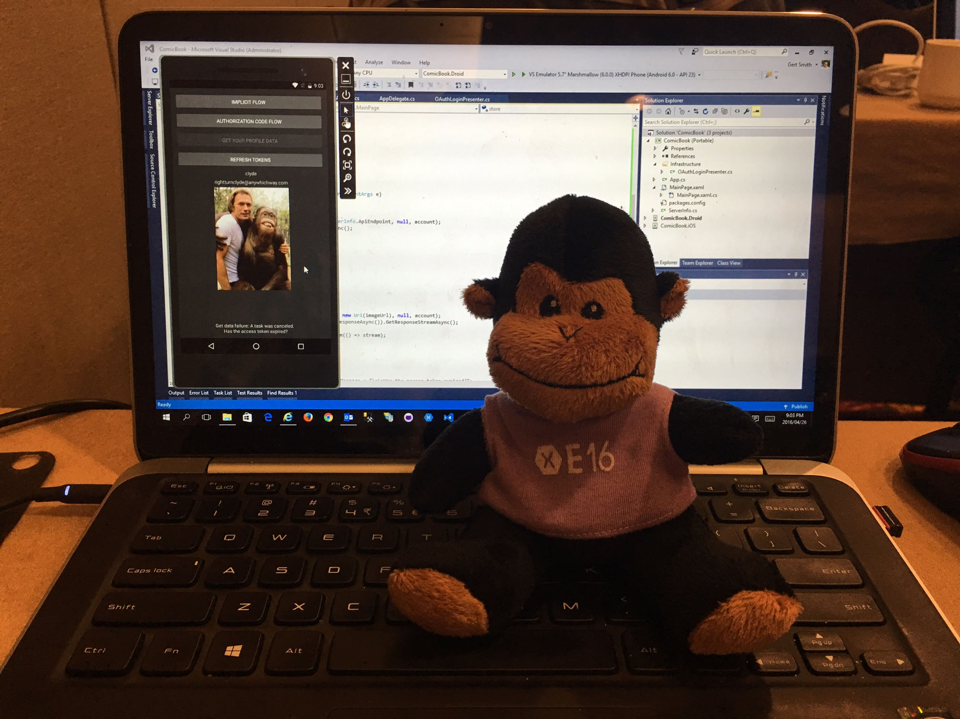
2 days Training
Fundamentals Track The Xamarin Mobile Platform Introduction to Xamarin.Forms Defining UI in XAML Cross-platform code strategies Working with REST services Data binding and MVVM Using the Xamarin.Forms | Intermediate Track Keeping your apps responsive Design patterns for cross-platform code sharing UI and Unit Testing with Xamarin Securing Local Data Authenticating with OAuth Diagnosing common memory issues

Slide 5
Keynote announcements…
Open Source Xamarin
Xamarin officially announced the open-sourcing and contributing of the Xamarin SDKs for iOS, Android, and Mac to the .NET Foundation under the MIT license. This includes the Mono runtime ports for iOS and Android, bindings to the native APIs, the basic command-line build tools, and Xamarin.Forms. Join us in building the future of mobile apps at open.xamarin.com, our portal for open-source at Xamarin.

Slide 6
Keynote announcements…
Xamarin Previews
Release Candidate for: Xamarin Studio Xamarin for Visual Studio Xamarin.iOS and Xamarin.Android Workbooks

Slide 7
Xamarin Previews continued…
Xamarin Studio
Xamarin Studio has been completely redesigned with over 5,000 new icons, a beautiful dark theme, and improved syntax highlighting. The type system has been completely rewritten to use Roslyn, bringing improved refactoring, code completion, formatting, and expanded support for C# 6. A new project model has been introduced to bring much greater compatibility to developers working in both Xamarin Studio and Visual Studio. Developers building apps in F# will also notice substantial improvements, including support for F# PCLs and Shared Projects.

Slide 8
Xamarin Previews continued…
Xamarin for Visual Studio
New iOS Simulator remoting allows you to interact with apps running with Apple’s iOS Simulator on Mac from your Windows machine as if the simulator were running locally. iOS USB remoting makes it possible to deploy and debug to an iOS device plugged into your Windows PC, and will be available in preview soon.

Slide 9
Xamarin Previews continued…
Xamarin.iOS and Xamarin.Android
Both Xamarin.iOS and Xamarin.Android now include native HTTP handlers, bringing speedier network operations to your mobile apps and allowing HttpClient to use any network and encryption protocols both iOS and Android are familiar with, such as TLS 1.2. Xamarin.Android uses a new Java invocation architecture, which reduces the size of Android apps by nearly 2MB (compared to previous releases), and may also improve app performance due to additional caching opportunities.

Slide 10
Xamarin Previews continued…
Workbooks
Workbooks are live documents that are great for experimenting, teaching, training, or exploring mobile development in C#. See an app come to life as you move step-by-step through an interactive coding workbook. Workbooks not only support C#, but also have deep integration with platform-specific APIs, so you can render colours, maps, and other mobile constructs directly from a workbook.

Slide 11
Keynote announcements…
Xamarin.Forms Updates
New features: Themes DataPages
Xamarin.Forms Previewer URL Navigation
Embedded Platform-Specific Controls

Slide 12
Xamarin.Forms Updates continued…
Themes
Themes give developers access to pre-designed UI elements, such as cards and contact lists, making it simple to build beautiful user interfaces with Xamarin.Forms. Light and Dark themes as separate NuGets. Can also create own themes, making it easy to ensure that developers across teams can create mobile apps with a consistent look-and-feel.

Slide 13
Xamarin.Forms Updates continued…
DataPages
DataPages make displaying data from a cloud datasource as easy as possible. Simply select a data source, enter your cloud credentials, bind your data, and click build. Xamarin.Forms not only handles connecting to the data source, but also creates master-detail pages from that data automatically, without any additional configuration.

Slide 14
Xamarin.Forms Updates continued…
Xamarin.Forms Previewer
The Xamarin.Forms Previewer renders a live preview of a page side-by-side with the corresponding XAML markup, directly within your Xamarin Studio environment.

Slide 15
Xamarin.Forms Updates continued…
URL Navigation
Deep link to any page in your Xamarin.Forms app with URL navigation, creating a more fluid experience across mobile search, web, email, and other app-external sources.

Slide 16
Xamarin.Forms Updates continued…
Embedded Platform-Specific Controls
Embed custom iOS and Android controls directly into your Xamarin.Forms apps in just a single line of code, without having to create a custom renderer or effect.

Slide 17
Keynote announcements…
The Mobile-Optimized Development Lifecycle
Xamarin Test Recorder for Visual Studio: Allows you to generate automated UI test scripts by launching it directly on an emulator or device, and interacting with it as your user would. Test steps are generated for you automatically and can be run locally or in the Xamarin Test Cloud.
Test Cloud Live: Test Cloud Live allows users to remote-debug a real device in Xamarin Test Cloud from within the browser, providing an extra level of detail sometimes needed to debug a complex issue.
Deliver, Monitor, Iterate: Xamarin Insights and HockeyApp are joining to deliver world-class app monitoring and continuous delivery.

Slide 18

Darwin Lounge
Stocked full of tech toys, massage chairs, Xamarin engineers, and a few really cool surprises, the Darwin Lounge was the place to hang out and relax between sessions. Code challenges Mini-Hacks for you to complete to earn awesome prizes.

Slide 19
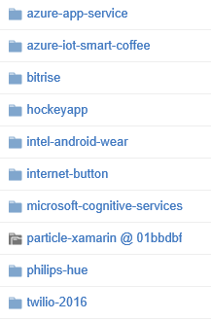
Darwin Lounge…
Mini hacks
Mini-hacks are designed to stimulate developers of all skill levels—each challenge comes with step-by-step instructions to guide you if you get stuck.

Slide 20
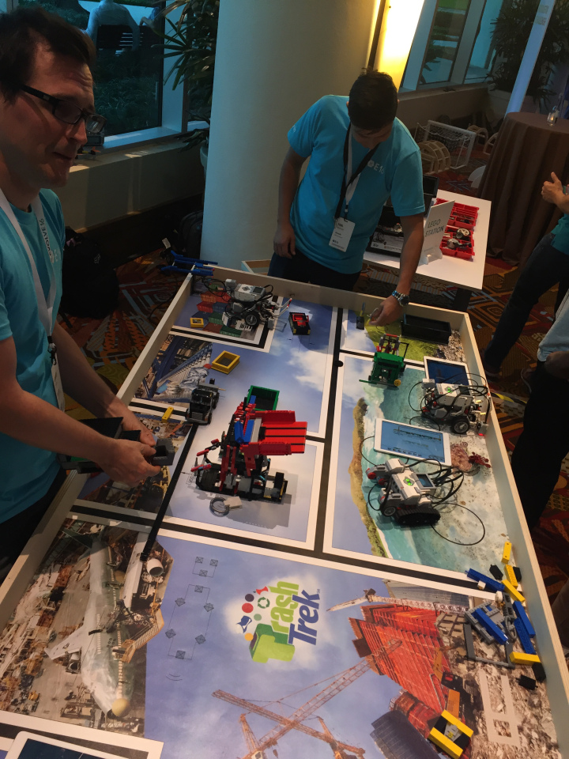
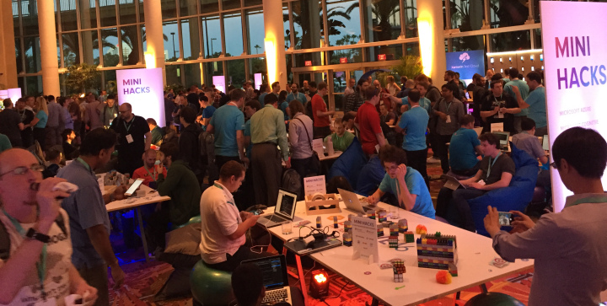
Darwin Lounge…

Slide 21
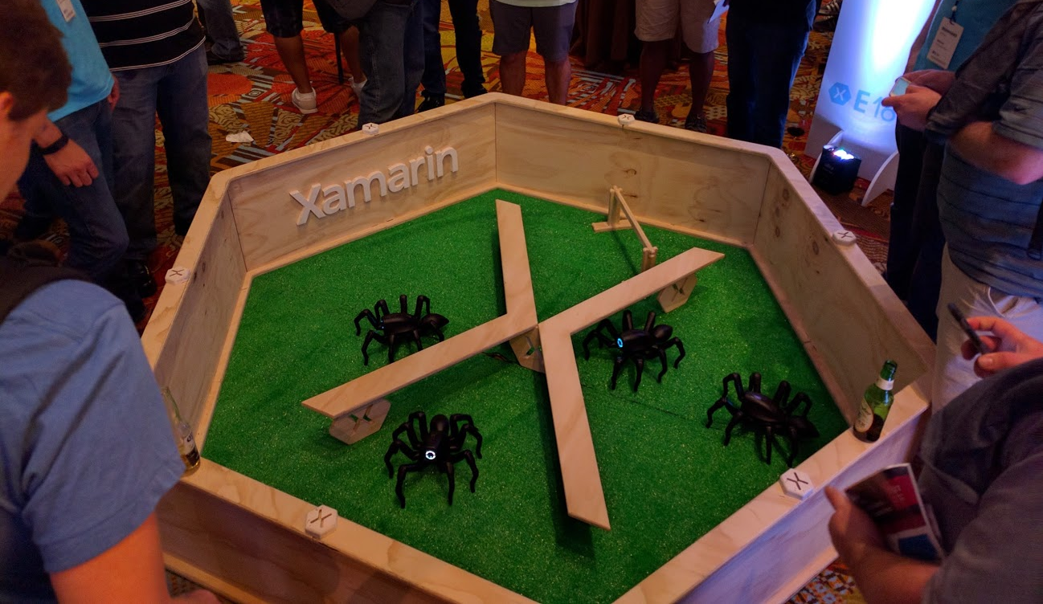
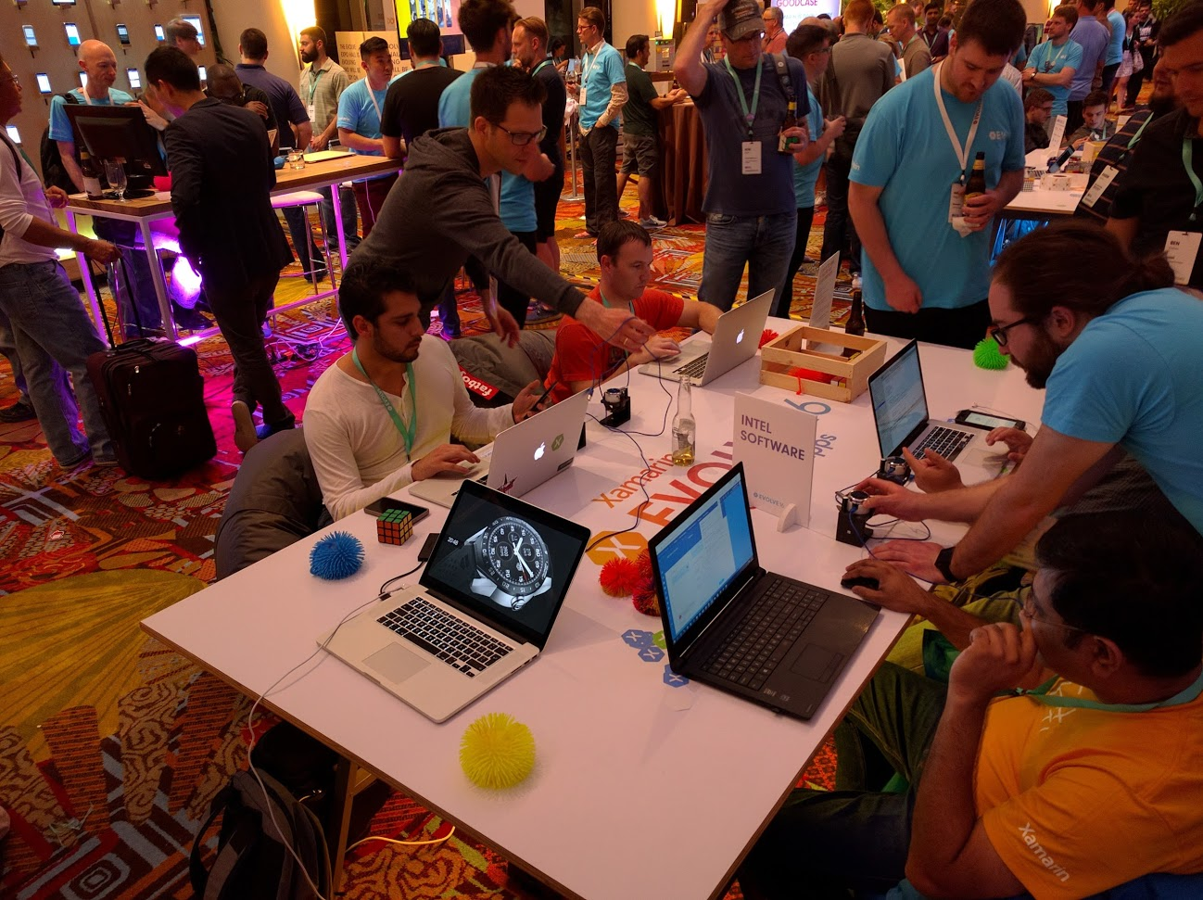
Darwin Lounge…

Slide 22
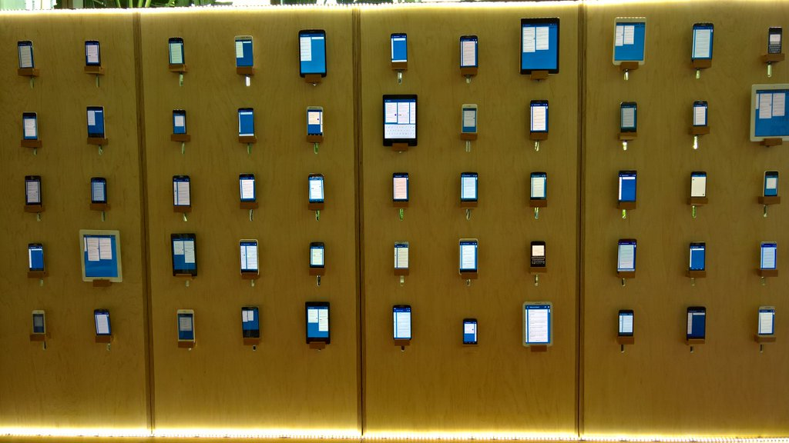
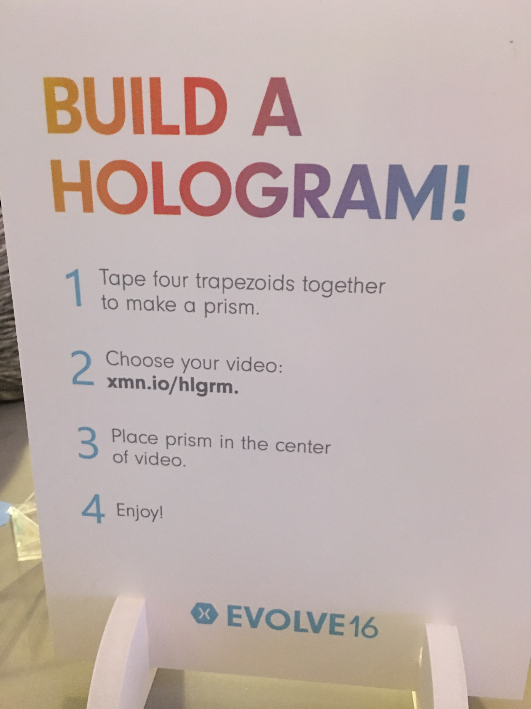
Darwin Lounge…

Slide 23

Xamarin Developer DNA

Slide 24


Evolution Meets Imagination
No lines, just fun! Xamarin Evolve 2016 threw an unforgettable celebration at Universal's Island of Adventure® theme park on Wednesday, April 27th. All night long, attendees enjoyed unlimited access to incredible rides and attractions including Harry Potter and the Forbidden Journey™

Slide 25



Slide 26



Slide 27
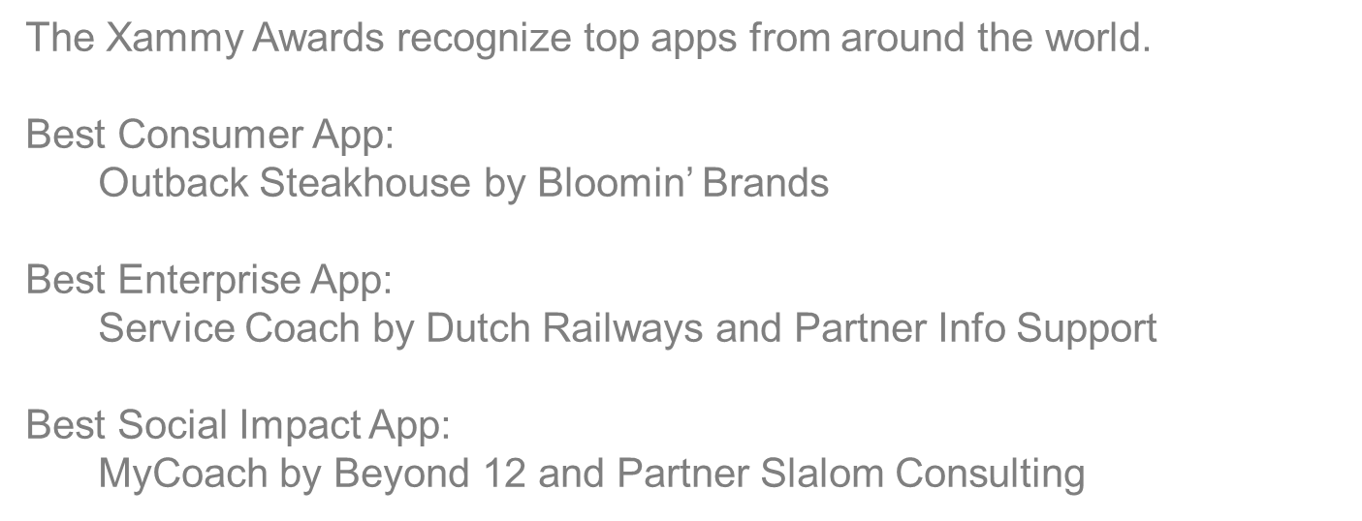
Xammy Awards

Slide 28
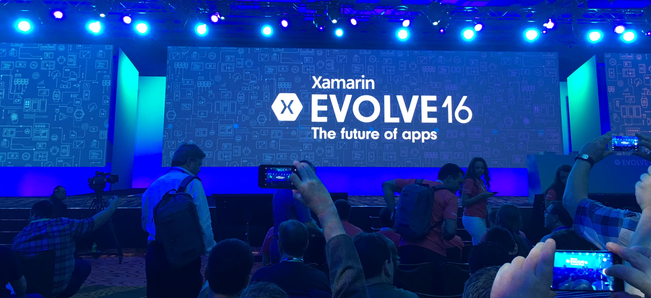
Xamarin Evolve 2016 Sessions
All recorded sessions available at: https://evolve.xamarin.com

Slide 29
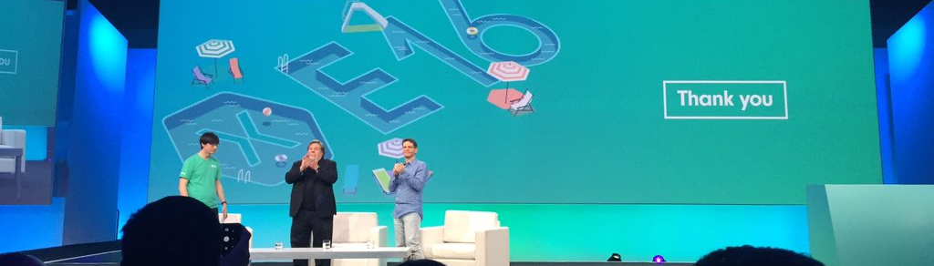

Slide 30
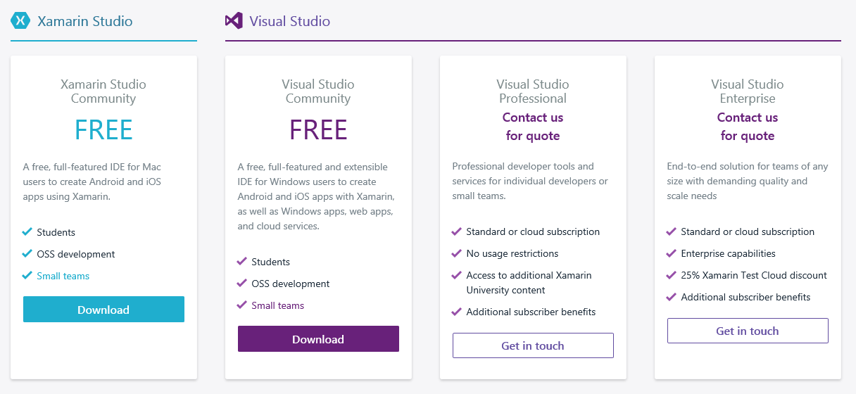
How Free is Xamarin really…

Slide 31
